Slide 1
BBMRI-ERIC & LS RI Cluster:
Benefits of ERIC
BE Presidency Conference
5 June 2024
Prof. Jens K. Habermann
Director General BBMRI-ERIC

Slide 2
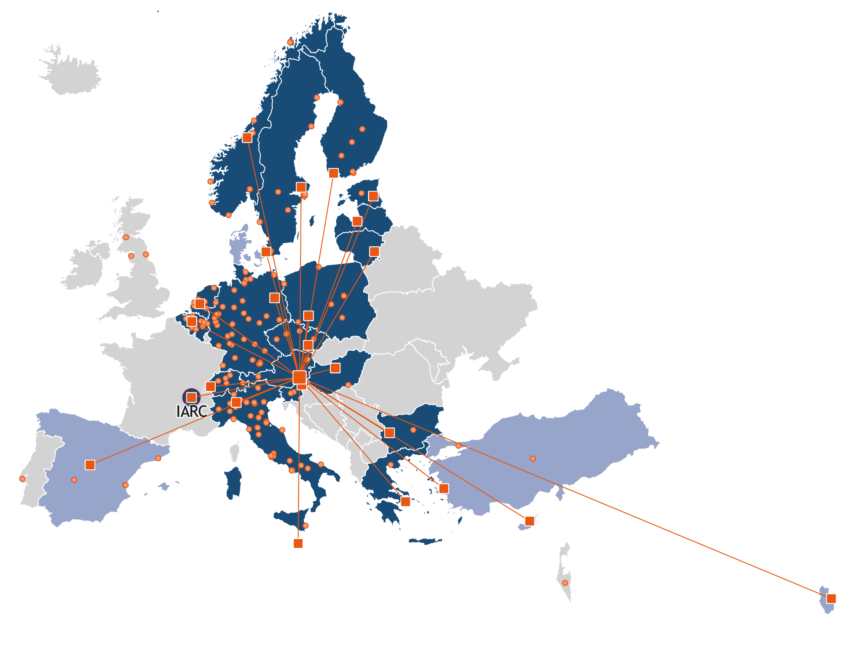
BBMRI-ERIC
A DISTRIBUTED LS RI
20
5
MEMBER STATES
OBSERVERS
Austria
Belgium
Bulgaria
Cyprus
Czech Republic
Estonia
Finland
Germany
Greece
Hungary
Italy
Latvia
Lithuania
Malta
Netherlands
Norway
Poland
Slovenia
Sweden
Switzerland
Denmark
IARC/WHO
Qatar
Spain
Turkey
COMMUNITY
> 400 biobanks
+ Affiliated partners
24 National Nodes + IARC/WHO
+ ELSI Expert Groups
+ QM Expert Groups
+ IT Expert Groups
3 Biotech Expert Centres
1 Headquarter
Notes:
Strengths:

Slide 3
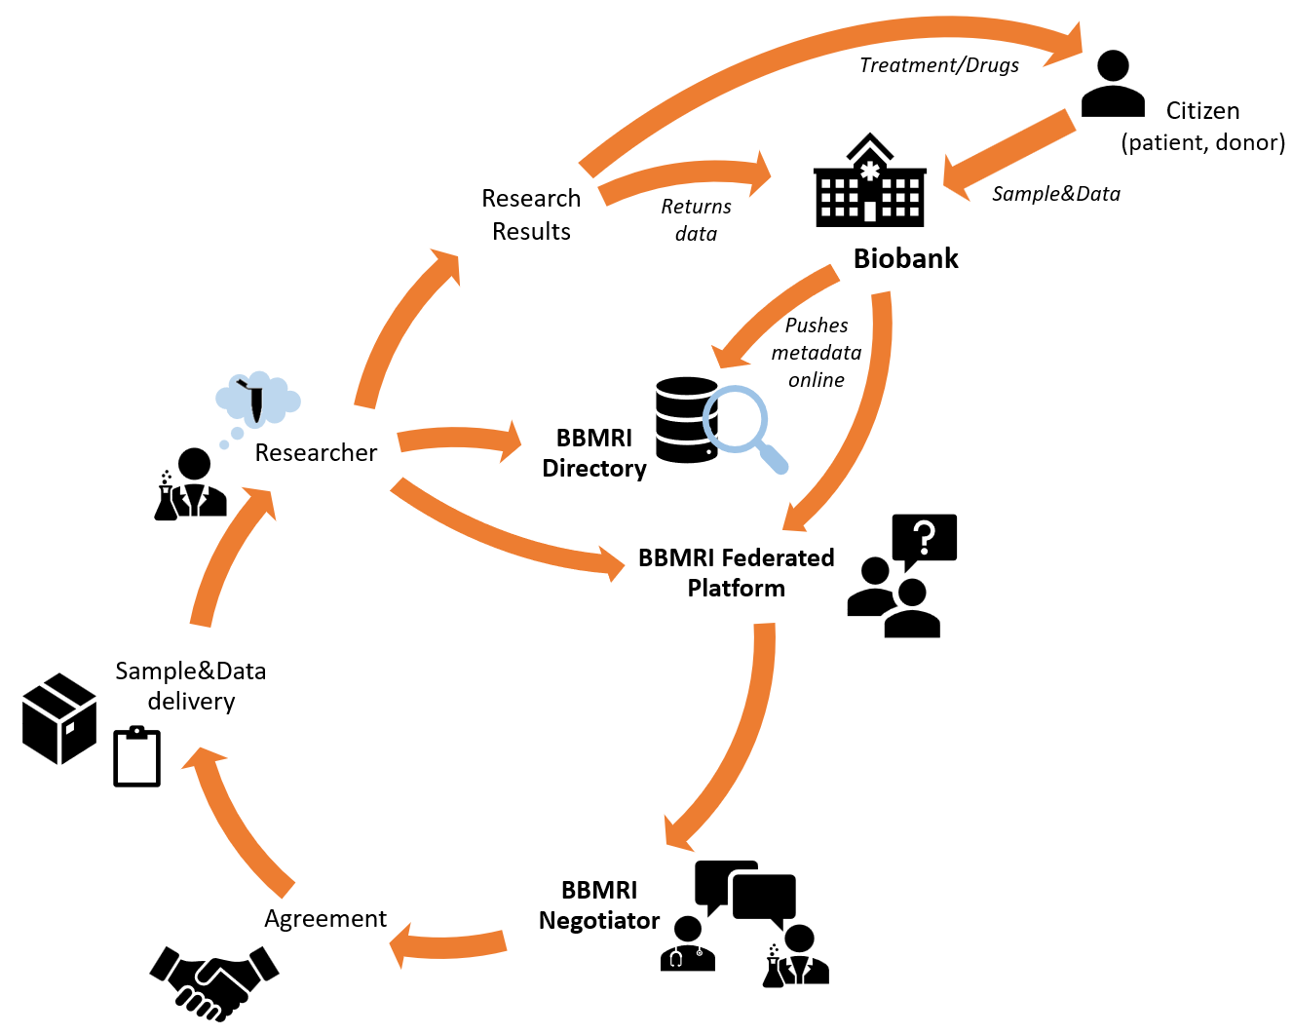
BBMRI-ERIC ACCESS
LIFE-CYCLE
BBMRI Directory largest biobank catalogue worldwide:
> 400 biobanks with
5.1 Mio. patients
across 32 countries and
9,000 users in 2023.
Federated Platform features 450,000 donors with 200,000 genomes across 10 EU countries today
Sample, Data & Service delivery

Slide 4
ONE HEALTH
DISTINCT BIOBANK TYPES
VARIOUS REQUIREMENTS
INTEGRATED
HEALTHCARE
BIOBANKING OPERATIONS AND DEVELOPMENT (BBD)
POPULATION
BASED
ETHICAL, LEGAL AND SOCIETAL ISSUES (ELSI)
HUMAN
BIOMONITORING
QUALITY MANAGEMENT (QM)
ENVIRONMENT
PLANT
DIVERSITY
INFORMATION TECHNOLOGY INFRASTRUCTURE (IT)
DOMESTIC AND
WILDLIFE

Slide 5
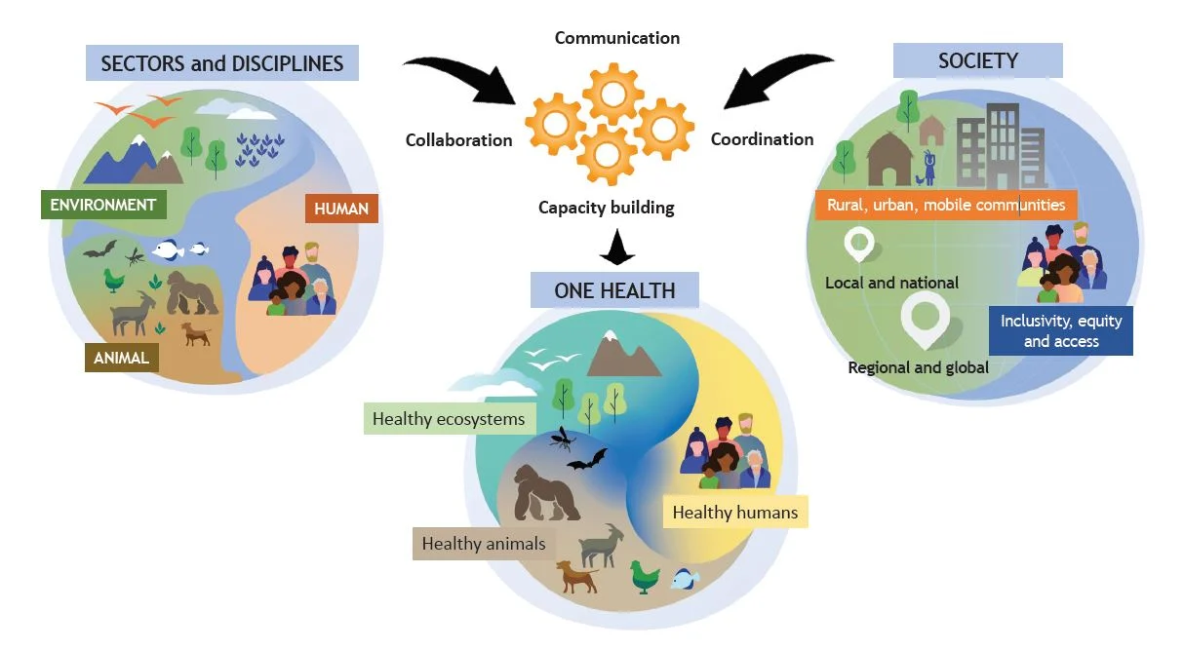
STRIVING TOWARDS ‘ONE HEALTH’
One Health is an integrated, unifying approach that aims to sustainably balance and optimize the health of people, animals and ecosystems.
It recognizes the health of humans, domestic and wild animals, plants, and the wider environment (including ecosystems) are closely linked and inter-dependent.
https://www.who.int/news/item/01-12-2021-tripartite-and-unep-support-ohhlep-s-definition-of-one-health
Notes:
One Health is an integrated, unifying approach that aims to sustainably balance and optimize the health of people, animals and ecosystems.
It recognizes the health of humans, domestic and wild animals, plants, and the wider environment (including ecosystems) are closely linked and inter-dependent.
The approach mobilizes multiple sectors, disciplines and communities at varying levels of society to work together to foster well-being and tackle threats to health and ecosystems, while addressing the collective need for clean water, energy and air, safe and nutritious food, taking action on climate change, and contributing to sustainable development.

Slide 6
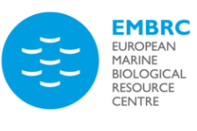
LIFE SCIENCE CLUSTER
WHO ARE WE?
14 European LS-RIs providing access to world-class facilities, experts, biological samples, instruments, services & data
Mission: support cutting-edge science by offering access to resources and services to academia and industry
Capacity building: offering training, education, consultation, standardization, harmonization
Largest cluster within ERIC Forum
Notes:
Graph is updated
Strengths of LS RI: Combining forces to support cutting-edge science by offering access to the latest technologies, comprehensive resource collections and technical expertise.

Slide 7
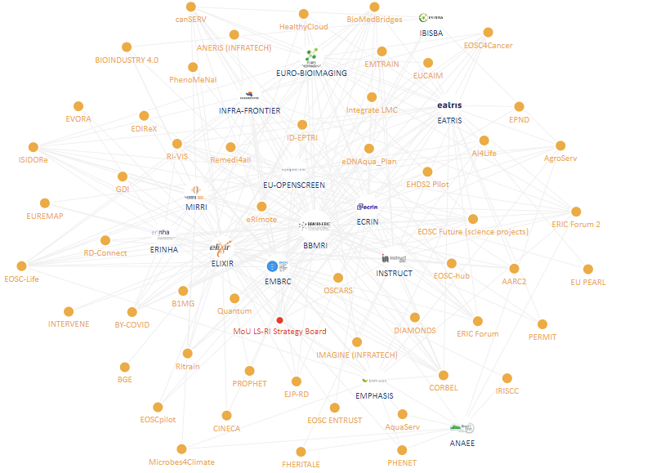
LIFE SCIENCE CLUSTER COLLABORATIONS FOR IMPACT
Notes:
Graph is updated
Strengths of LS RI: Combining forces to support cutting-edge science by offering access to the latest technologies, comprehensive resource collections and technical expertise.

Slide 8
13 Infrastructures with 150 Service Providers
Defragmenting ERA in cancer research
Easy access to cutting-edge expertise, tools and services across Europe
One single entry point for researchers
One European Molecular Tumour Board (MTB) Network with MTB Outcome Registry
400+ Services in 10 Research fields
UNCAN.eu + EOSC
150+ applications from 32 countries

Slide 9
5
LS RIs CONNECTING RELEVANT EU INITIATIVES
European Health Data Space (EHDS2pilot)
Cancer Mission & Beating Cancer Plan (e.g., canSERV, EOSC4Cancer, EUCAIM, UNCAN.eu)
1
EOSC Association e.g., Corbel, EOSC-Life, EOSC Future)
4
European Partnerships in Horizon Europe (Personalised Medicine, Rare Diseases)
Pandemic Preparedness
(e.g., ISIDORe, BY-COVID)
2
3

Slide 10
ERIC FORUM 2 PROJECT
ERIC Forum Project 2.0 addresses key topics for ERIC implementation and operation, such as:
ERIC Regulation implementation
ERICs and European Science Policy & Research Strategy
Internationalisation and engagement with 3rd countries
Greening of RIs
Personnel-related challenges
Cooperation with ERICs-to-be

Slide 11
STRENGHTS OF ERIC MODEL FOR BBMRI
Continuous growth thanks to country-level participation: from 12 members/observers in 2013 to 25 members/observers in 2024
Well functioning governance model that is embedded in the Statutes
Decision-makers in national ministries and EU Commission well acquainted with the ERIC specificities and the legal model → smooth cooperation with ministries
VAT exemption (although still challenges with certain partners!)

Slide 12
STRENGHTS OF ERIC MODEL FOR BBMRI AND LS RIs
Possibilities for a strong contribution to EU research policy priorities across health and life sciences (and cross-clusters)
Pooling of European and Member State resources with a pan-European alignment on health research and related topics:
Need for EU policy-makers to encourage new initiatives to cooperate more with exiting ERICs/RIs – avoiding defragmentation of RI landscape is a must!
Collaboration on a range of activities via ERIC Forum 2 project: a strong ERIC community with expertise at the core of ERA
Notes:
NOTE: note all LSRIs are ERICs!

Slide 13
THANK YOU!
Jens.Habermann@bbmri-eric.eu
www.bbmri-eric.eu

